Slide 1
Nationwide Building Society: Measure For Learning
Marc Price Product Owner, Nationwide Building Society
Zsolt Berend Business Agility Coach, Nationwide Building Society

Slide 2

What we cover
Our journey
From Antipatterns to Patterns
Our product
Voice of the customer

Slide 3
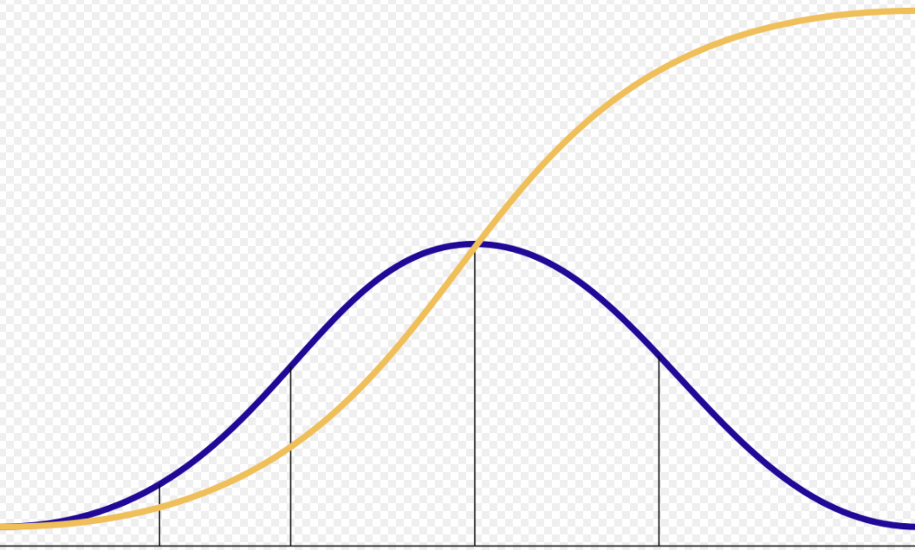
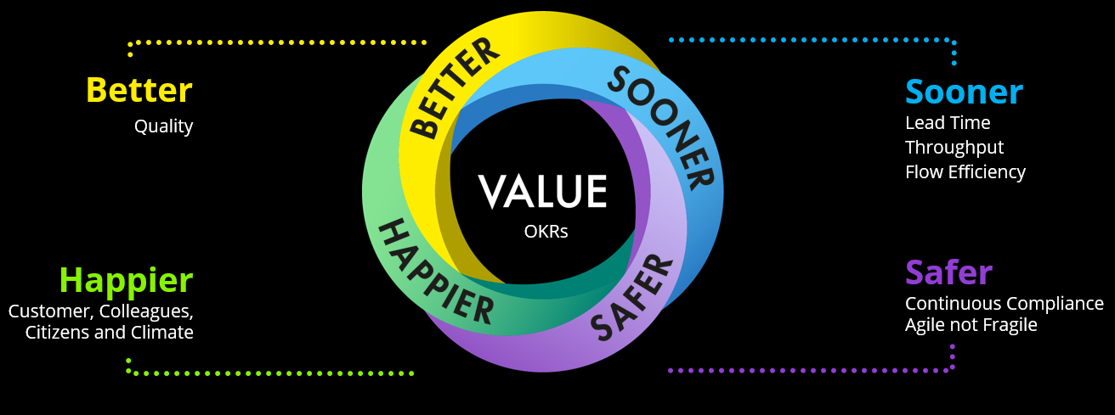
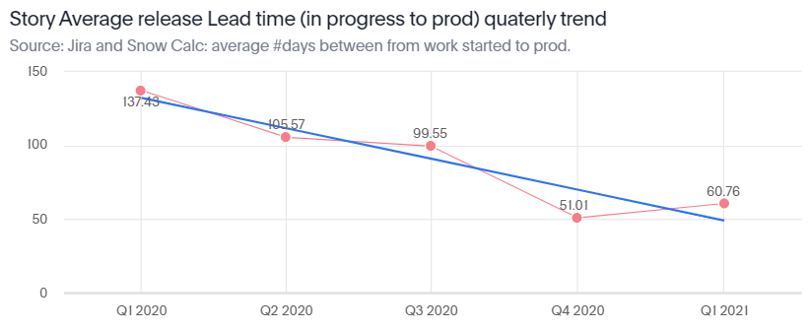
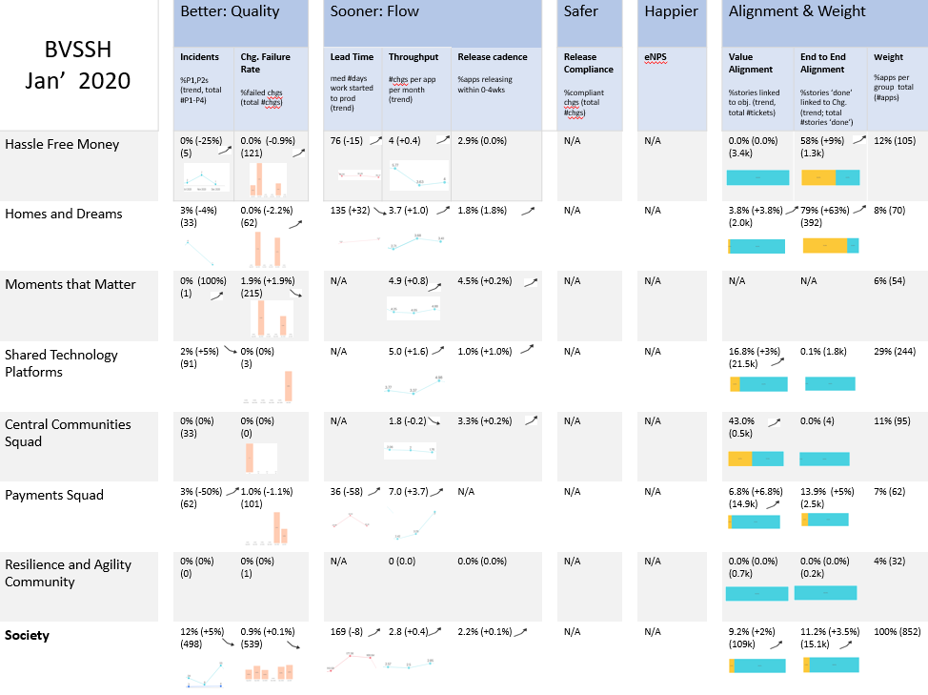
Our journey
160+ self-serve insight boards on flow, quality and alignment
Sooner Safer Happier Pattern:
Invite over Inflict
Unlocking measurability of Flow end to end
We need a product
C-suite level insights
Q4 2019
Q2 2020
Q4 2020
Q2 2021
Manual reports
Output measures
Q1 2020
Innovators Early adopters
Show & tells
Q3 2020
Q1 2021
900+ colleagues at all levels across the Society
Crossing the Chasm
UK IT Awards finalist

Slide 4
On the journey to moving from Antipatterns to Patterns
From
To
Measuring Outputs (e.g. #features, #storypoints) |  | Measuring Outcomes (Better, Value, Sooner, Safer, Happier)
Centralized, and often manual reports |  | Self-serve discoverability of auto-harvested data, metrics and insights
Weaponised metrics (focusing on achieving a target) |  | Measure for learning (focusing on maximising outcomes & learning)
Disconnected datasets, no or limited measurability of flow, quality, value |  | Unlocked measurability of flow, quality, value

Slide 5
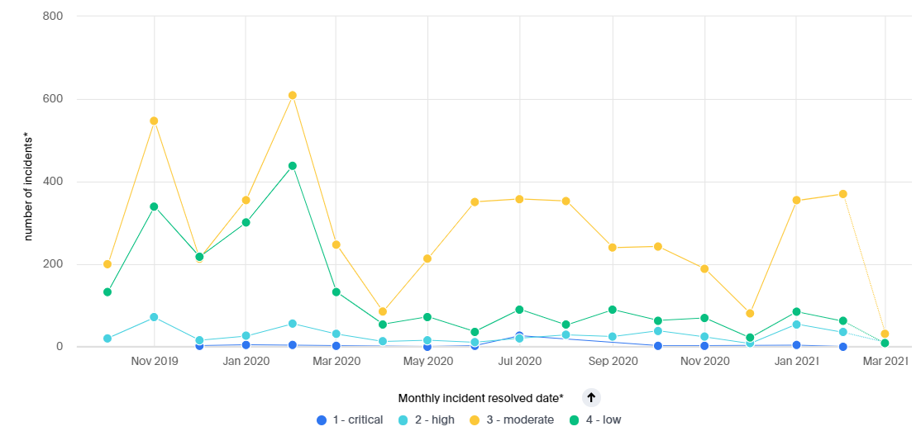






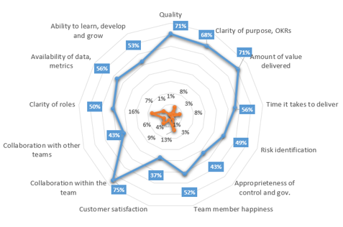
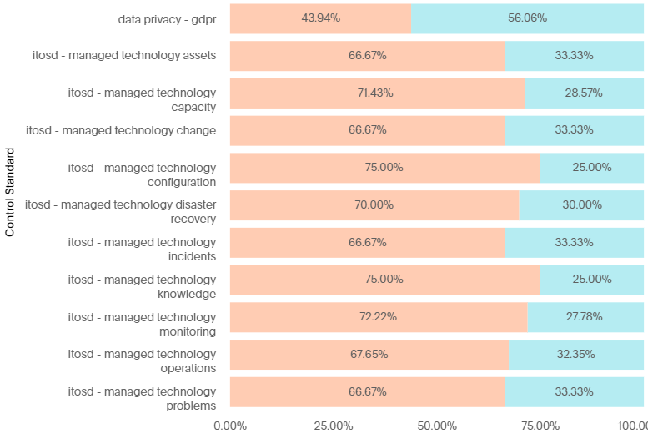
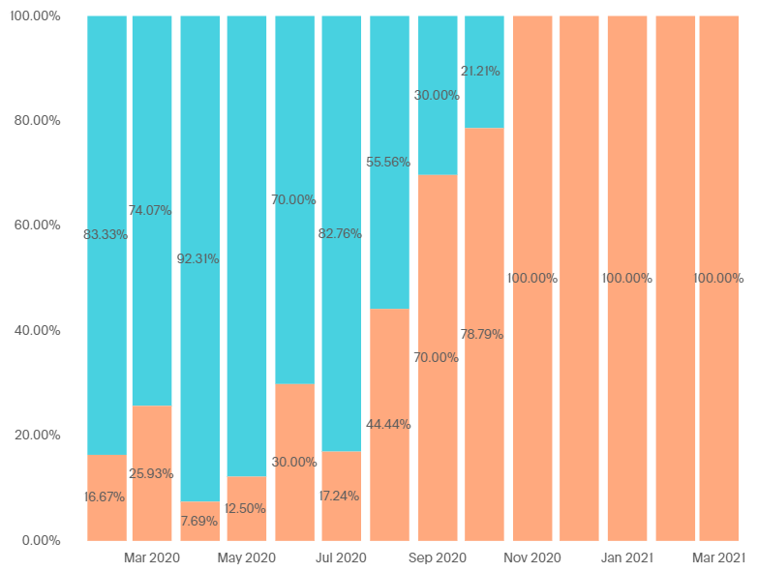
Measure for Learning
Better
Value
Sooner
Safer
Happier
Better
Quality
Sooner
Lead Time
Throughput
Flow Efficiency
Happier
Customer, Colleagues,
Citizens and Climate
OKRs
Safer
Continuous Compliance
Agile not Fragile

Slide 6
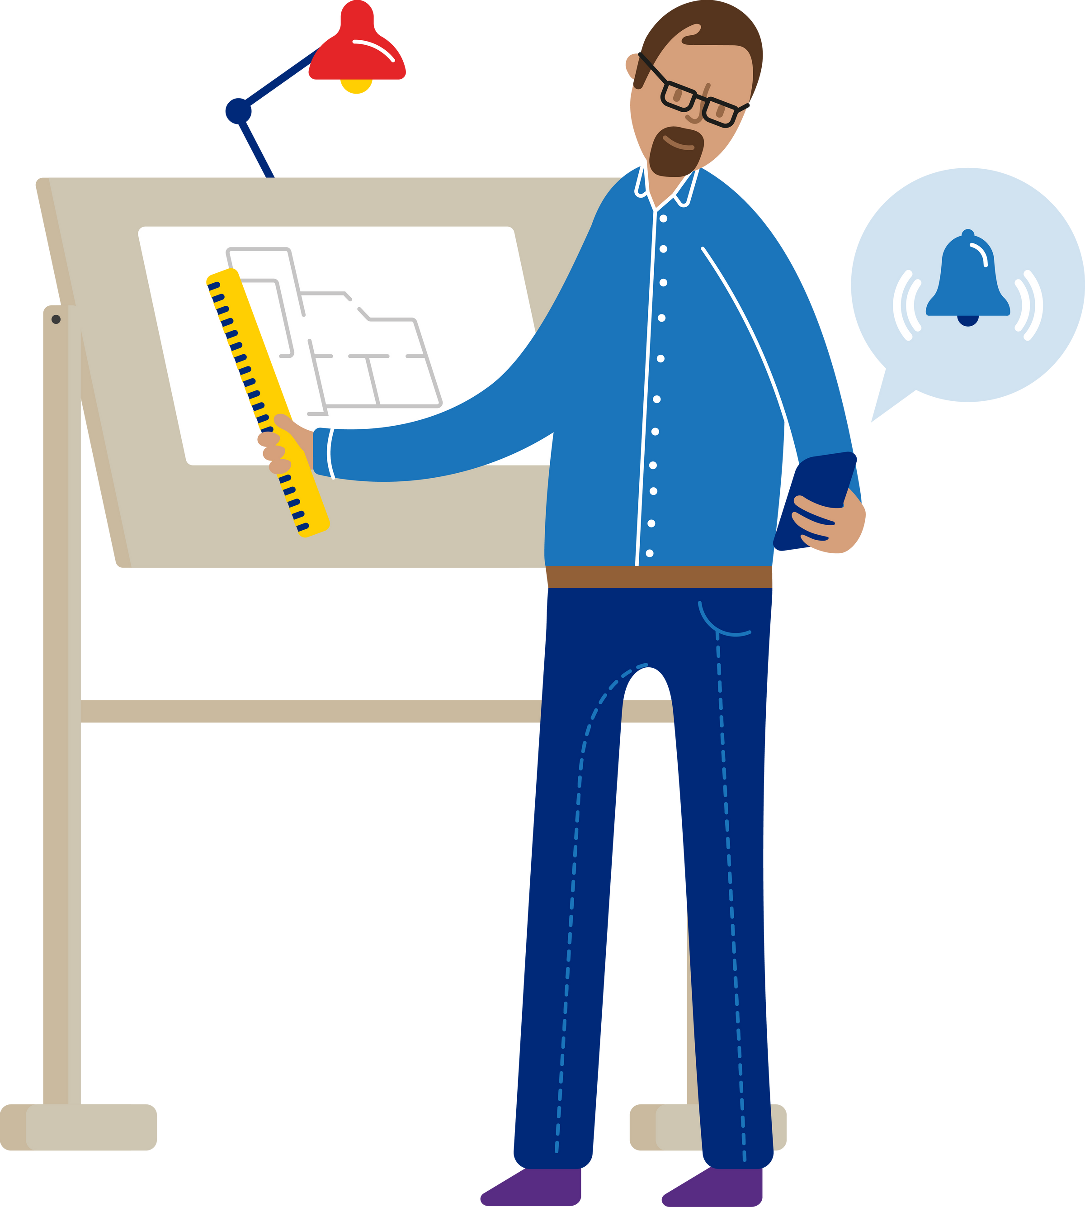
Our product

Slide 7

Voice of customers

Slide 8
Final thoughts and thank you

